Slide 1
Agenda
9:00 - 9:10 Welcome and Agenda
9:10 - 9:55 MLE overview lecture, review of Week 1 content
10:00- 11:00 Guest Speaker: Muazma Zahid Principal Engineering Manager, Microsoft
-30 mins moderated Q&A, 15 mins questions from students
11:05 - 11:30 Introduction to today’s assignment: Data Science @ Tesla
11:30 - 12:00 Breakout part #1 of assignment
12 - 12:30 Lunch
12:30 – 12:35 Whole Group Check-in
12:35- 1:40 Breakout part #2 of assignment (will be made available over lunch)
1:40- 1:45 Whole Group Check-in
1:50-2:20 Breakout part #3 of assignment
2:20 - 2:35 Stay in Breakout: and do Ethics task assignment
2:35 - 2:50 Ethics Discussion
2:50 - 3:00 Wrap Up and Feedback Form

Slide 2
Updates
Zoom link for each Saturday is the same, always in the Home section of Canvas
Link to today’s schedule in Zoom chat
Assignments tab in Canvas only shows you upcoming assignments (not handouts, videos)
Modules tab (week 0, week 1, etc. shows you all the material for the week)
Later in talk today I will elaborate on Breakout Room expectations, also fixed 30 minute limit
Lecture slides before lecture– I will try but as I make them throughout the week often done on Friday
Will post lecture slides after lecture and link to youtube lecture
Fridays I release the content for the following week
Fridays I release the Saturday Live Coding assignment if you want to review
I am going to use Raise Hand to answer questions.
If you want to ask questions in Zoom chat to Yiming and Rajesh you may
If math questions or whatnot really involved, I may have to answer later
I will have added more breaks in between sections

Slide 3
What is an MLE? Connecting the Dots
Week 1
Bernie Boscoe

Slide 4
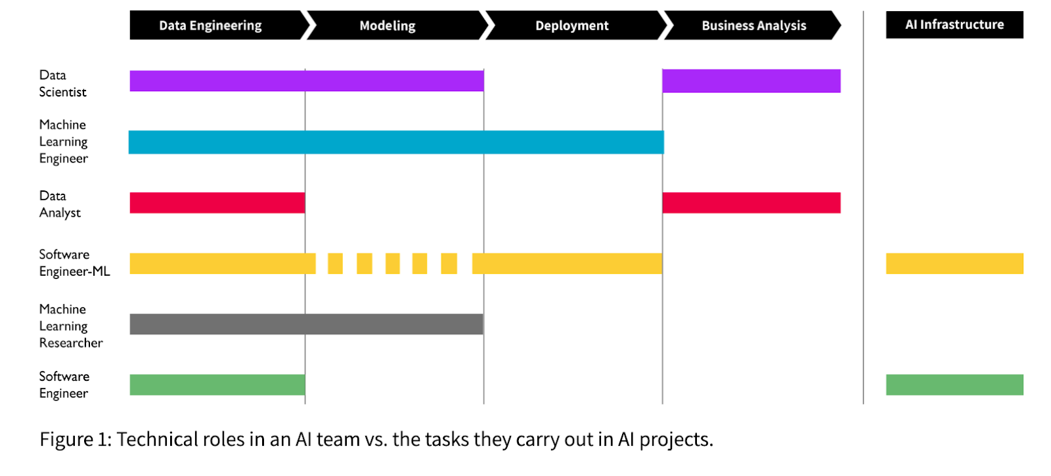
What is an MLE vs a Data Scientist, etc.
Source: Workera.ai

Slide 5
MLE functions (this varies widely!)
Research Stage (Exploratory):
Data (Domain) Scientists prepare, clean data – traditional statistical methods, local methods
Form research questions
Approach the MLE
Can this be solved using machine learning?
If yes– MLE suggests appropriate models, suggests metrics
DS tinkers, iteratively, possibly may need to reframe data for ML approaches
Beginning Dev Stage:
How to implement at scale? (MLE strong suit)
Evaluate economic value (or scientific value)
Deployment
Pipeline building and testing
Monitoring
Retraining/adding new data

Slide 6
In sum:
MLE
Broad knowledge of ML algorithms and associated metrics
Deep knowledge of methods that work well with ML
Skilled with data at scale
Writing production code
Understanding steps in deployment
Able to communicate to various stakeholders
Understanding of deployment platforms and data management
Pipeline maintenance
Or, minimally, understanding how people with these skills on the team work together and using critical thinking to solve problems!

Slide 7
A Brief Summary on Metrics
Classification Metrics: Accuracy, precision, recall, F1-score, ROC, AUC
Regression Metrics: MSE, MAE
Ranking Metrics: MRR, DCG, NDCG
Statistical Metrics: Correlation
Computer Vision Metrics: PSNR, SSIM, IoU
NLP Metrics: Perplexity, BLEU score
Deep Learning Metrics: Inception score, Frechet Inception distance
GAN metrics: By eye

Slide 8
Applications of Regression
Week 1
Bernie Boscoe

Slide 9
Learning Objectives
Implement Linear and Non-linear regression models on real-life sample problems.
Understand the output metrics and parameters to assess regression models.
Visualize and report model outcomes after benchmarking across several methods.
Understand the difference between correlation and causation.
Analyze outcomes (under predictions/over predictions).

Slide 10
Regression Definition
Wikipedia says
“Regression analysis is a set of statistical processes for estimating the relationships between a dependent variable (often called the 'outcome variable') and one or more independent variables (often called 'predictors', 'covariates', or 'features’).”
Source:https://en.wikipedia.org/wiki/Regression_analysis
Notes:
Size of home (x), price of home (y)
Body weight, Blood glucose level etc.

Slide 11

Gradient Descent Solutions
Why use Gradient Descent when Normal Equations can be solved?
Ans: To solve normal equations,
-Computational complexity is O(n³), for n dimensions.
-As n grows, complexity explodes.
-Iterative solutions in batches is better for optimization.
θ$={(X^{T}X)}^{−1}X^{T}Y$
Source: https://medium.com/@savannahar68/getting-started-with-regression-a39aca03b75f
Correlation does NOT imply Causation!

Slide 12
Some Applications of Regression…
Business Optimization Use Cases.
Easy: To understand the relationship between oven temperature and shelf-life of baked cookies.
To know the relationship between wait times of callers and number of complaints.
Not Easy: To find the leading cause for faulty part production and eliminate it.
The HR Department, intends to identify divisions with most churn to redesign bonus.
Medical Use Cases:
Easy: To find relationships between body weight and diabetes, blood pressure etc.
Find the relationship between household salary, no. of hospital visits etc. for insurance premiums.
Not Easy: To allocate a risk factor towards flu-like diseases based on pre-existing conditions.
A pharma company intends to find relative risk between pre-existing conditions and new drug.
Notes:
Less wordy!

Slide 13
What we have so far…
Models
-Linear Regression
-Gradient Descent,
-Normal Equations,
-Generalized Linear Models (GLM)
-Non-Linear Regression
-Decision Trees (CART)
Data
Check for:
Multi-collinearity
Independence of identically distributed variables
Heteroscedasticity

Slide 14
Computational Complexity
POLL
Gradient Descent: O(kn²), for n-features, k-iterations.
Normal equations: O(n³), for matrix inversion.
Generalized Linear Models: O(n³ + mn²)
Decision Tree: O(m.mn)=O(m²n) [number of voters*complexity per tree]

Slide 15
Regularization: To avoid overfitting (this lecture piece is in Canvas)

Slide 16

Need for Regularization
Case 1 (Ideal): More samples, less features!
X
X^{T}
X
*
nxd
n>>d
dxd, full rank
θ$={(X^{T}X)}^{−1}X^{T}Y$

Slide 17

Need for Regularization
Case 2 (Not Ideal): More features, less samples!!
X
X^{T}
X
*
nxd
d>>n
dxd, not full rank
$$\text{θ}={(X^{T}X+λI)}^{−1}X^{T}Y$$

Slide 18




Types of Regularization
Cost function to minimize (OLS):
L1 regularization (methods: Lasso, LARS):
L2 regularization (ridge regression):
L1 and L2 Combined (elastic net):
λ is the shrinkage quantity that decides importance of features.

Slide 19




L1 Regularization and Sparsity
If λ is low, similar to OLS,
If λ is high, it shrinks most feature weightage to ZERO.
$J_{θ}$is differentiable everywhere but at $θ=0.$
Update rule modification:
If $θ$>0, λ>0 pushes $θ$ to be less positive,
If $θ<$0, λ>0 pushes $θ$ to be less negative, Thus inducing sparsity!

Slide 20

L2 Regularization
If λ is low, similar to OLS,
If λ is high, importance shifts away from least squares.
Update rule modification:
Sensitivity of L1 and L2 to θ:
Sign of θ: L1 and L2
Magnitude of θ: L2
Doubling weightage to shrinkage parameter: L2
Elastic Net uses best of both worlds from L1 and L2 regularization!

Slide 21
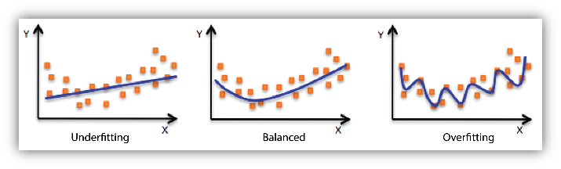
Mock Interview Questions
Q1. What is Elastic Net Regularization for Regression?
Q2. What is overfitting and underfitting ? Give examples. How do you overcome them?

Slide 22
Data Requirements: To ensure generalizable data models

Slide 23
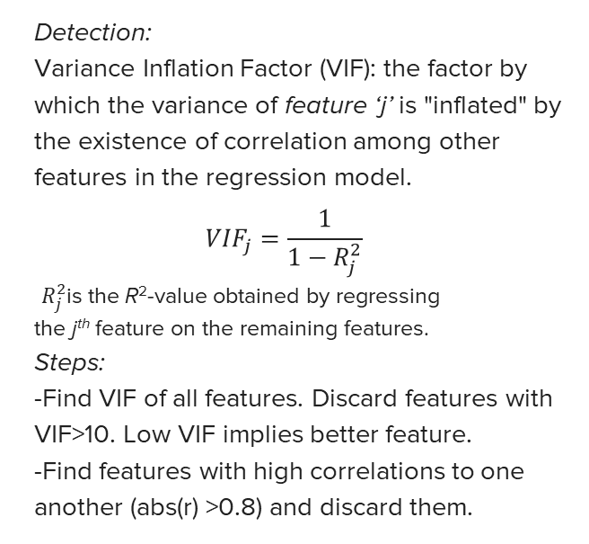
1. Multi-collinearity Corrections
Why?
What?
Meaning:
It means one independent variable can be predicted from another independent variable.
Reasons for Occurrence:
-Dependent features collected for data set.
total electricity cost, number of electrical outlets
-New features engineered on old features.
BMI created from weight and height
-Similar feature inclusion.
Temperature in centigrade and kelvin
Detection:
Variance Inflation Factor (VIF): the factor by which the variance of feature ‘j’ is "inflated" by the existence of correlation among other features in the regression model.
$${VIF}_{j}=\frac{1}{1−R_{j}^{2}}$$
$R_{j}^{2}$is the R²-value obtained by regressing the j^{th} feature on the remaining features.
Steps:
-Find VIF of all features. Discard features with VIF>10. Low VIF implies better feature.
-Find features with high correlations to one another (abs(r) >0.8) and discard them.
Notes:
Difference between multi collinearity and correlation!

Slide 24
2. Test For Independent, Identically Distributed (IID)
-Divide the data into Train/Validation/Test
-Stratified Sampling should yield mean and std dev errors for Validation Data within 1-std dev.
-If errors vary largely across samples, data may not be IID.
Solutions:
Cross Validation
Bootstrapping (Bootstrap Aggregation)
3. Heteroscedasticity occurs when the standard deviations of a predicted variable, over different test samples are non-constant.
Solution:
Weighted Least Squares (WLS)

Slide 25
Live Assignment: Data Science @Tesla (Access your existing codebooks)

Slide 26

The Problem
You have access to sales records from Q1-4 in 2019.
Company wants to streamline manufacture process and gauge interest in producing make/engine/sales version for a car based on past year/quarter sales.
You need to answer 2 major questions:
(Correlation) Is it possible to predict which car models are more popular than others so parts can be pre-ordered for those cars?
(Causation) Is it possible to pinpoint why some cars combinations did not sell as much or why others sold more? Do promotions really work?

Slide 27
One-Hot Encoded Data: For categorical unordered data
State | City | OrderID
California | San Jose | 12345
Washington | Redmond | 01234
Washington | Seattle | 00235
California | Sacramento | 54321
2
4
=6 columns
+

Slide 28
State | City | OrderID
California | San Jose | 12345
Washington | Redmond | 01234
Washington | Seattle | 00235
California | Sacramento | 54321
State_Cali | State_Wash | City_SJ | City_Sac | City_Red | City_Seattle
1 | 0 | 1 | 0 | 0 | 0
1 | 0 | 0 | 1 | 0 | 0
0 | 1 | 0 | 0 | 1 | 0
0 | 1 | 0 | 0 | 0 | 1
These columns are inverse of all other columns of same category, hence dropped

Slide 29
The Data
Sales records from California in 2019: Car Make, engine, sales version (packages). [Categorical Data]
Some new models are launched in July of each year and some last year models are discontinued in July.
All car model combinations are always NOT available in the year! (inventory-based choice).
Lead times between order and pick up can vary 3-6 months.
Need for Data Wrangling!
Car Make | Engine Type | Sales Version
S60 | A | 10

Slide 30
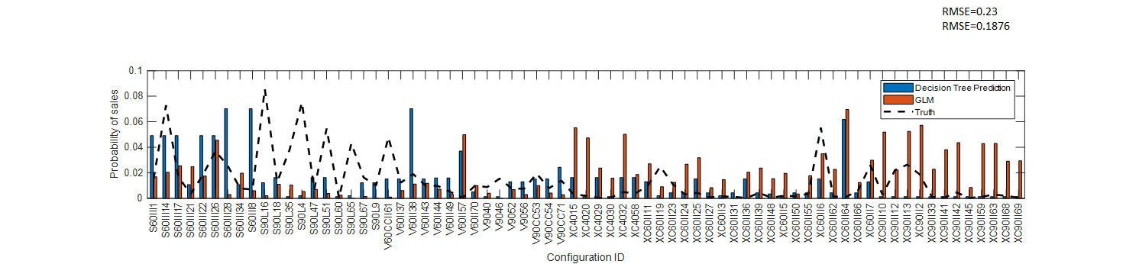
Expected Outcomes
Best Data Model to predict Q3-4 sales based on Q1-2 sales. (ensure optimal solution)
Analysis as to why some cars sold more or less than expected? Was it due to promotions?
Under-Predictions
1 2 3 4 5 6 7 8 9 10 1112 13 14 15 16 17 18 19 20 21 22 23 24 25 26 27 28 29 30 31 32 33 34 35 36 37 38 39 40 41 42 43 44 45 46 47 48 49 50 51 52 53 54 55 56 57 58 59 60 61 62 63 64 65 66 67 68 68 69 70 71 72 73 74 75
Car Model ID
Over-Predictions

Slide 31
Assignment Tasks and Deliverables
Task 1: Data Pre-processing
Task 2: Gradient Descent
Task 3: Normal Equations
Task 4: GLM and Decision Trees
Task 5: Analysis of at least 1 over/ 1 significant under prediction. Check if the variation in prediction from reality is because the same car combination sold differently in Q12 or was it a new model, so the predictions are off? Report 1 line of comment for under and over prediction.

Slide 32
Expectations for Break-Out Sessions
Discuss the possibilities regarding function creation for each task.
Consider dividing activities like:
search pandas commands,
search numpy commands etc.
Work though high-level sub-tasks to discuss after breakout.
Collect questions and concerns to be discussed after breakout.

Slide 33
Tentative Time Schedule for Breakout Sessions
Breakout session begins now (mainly for Task 1-2). Review all tasks. Do you understand them? Do you have an idea of what to do?
10:55 - we will return to whole group and check in on any questions you have. Then return to breakout sessions
Sven and Sohini will be circulating among groups. Ask them using Slack to join your group if needed.
11:05 - 12: you should complete Tasks 1 and 2 before lunch. (version 2 of coding assignment will be made available).
1- 1:05: Whole group checkin after lunch about your progress, any questions relevant to group.
1:05- 1:55: Breakout Session for Tasks 3-5.
1:55-2:10pm: we will return for a whole group and check in on any questions regarding Tasks 3-5. (version 3 of coding assignment will be made available.)
2:10-2:30: Breakout session to complete as much as possible.
2:30-2:35: Discuss as a group on what else is needed to complete assignment.
2:35 pm: Return for discussion on Ethics and fill out Feedback form.
Submit coding assignment by midnight Saturday.

Slide 34
Ready to Submit

Slide 35
Ethics: Introduction to Bias and Privacy
Consider the situation that your team is now being invited to partner with the “Personalization” team to see if you can use more user-specific data with the hope of improving prediction accuracy. Discuss:
The dataset used today does not contain any data about purchasers. As is, does GDPR apply?
The market research and personalization team can give you this dataset augmented with information about the individual purchasers. What implications does it have if you re-run the model with this information?
Will personalization actually help you make a prediction?
You should use the smallest number of features that work. Do you actually want the personal data?

Slide 36
Learning Objectives checklist
Implement Linear and Non-linear regression models on real-life sample problems.
Understand the output metrics and parameters to assess regression models.
Visualize and report model outcomes after benchmarking across several methods.
Understand the difference between correlation and causation.
Analyze underlying limiting conditions (under predictions/over predictions).

Slide 37
Q. What is overfitting and underfitting ? Give examples. How do you overcome them?
Food for thought!

